Slide 1

CS 360 Programming Languages Day 8

Slide 2
Recap everything we missed
First-class function
Lambdas
Higher-order functions
Practice:
Map
Filter
Foldr

Slide 3
Recap
First-class Functions
Lambda expressions
Warm-up: write a lambda expression which takes in two points, a and b, and returns the distance between them
Higher-order Functions
Warm-up: write a function pairs-to-nums which takes in a function f and a list of pairs pairs and applies f to each pair to construct a list of numbers.

Slide 4
Map
pairs-to-nums is an example of a higher-order function which maps pairs to numbers according to some rule (or function) f
This behavior is a common pattern:
Map numbers to their squares
Map usernames to email addresses
Map strings to their lengths
(define (map f lst)
(if (null? lst) ‘()
(cons (f (car a)) (map f (cdr lst)))))

Slide 5
Filter
Similarly, it’s common to filter out certain elements
Examples:
Keep all positive numbers
Keep all “valid” strings
Keep all courses that will make
(define (filter f a)
(cond ((null? a) '())
((f (car a)) (cons (car a)
(filter f (cdr a))))
(else (filter f (cdr a)))))

Slide 6
What else can we do?

Slide 7
(define (length lst)
(if (null? lst) 0
(+ 1 (length (cdr lst)))))
(define (sum-list lst)
(if (null? lst) 0
(+ (car lst) (sum-list (cdr lst)))))
(define (map func lst)
(if (null? lst) '()
(cons (func (car lst)) (map func (cdr lst)))))
All of these have:
A base case when the list is null (orange)
A return value for the base case (green)
A recursive case where we combine (red) something with the car of the list (purple) with a recursive call on the cdr (blue)

Slide 8
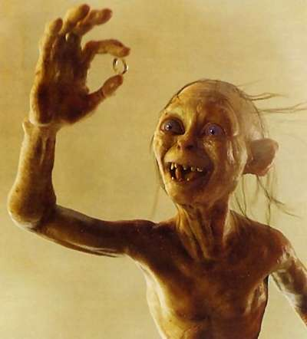
One function to rule them all
(define (foldr func base lst)
(if (null? lst) base
(func (car lst)
(foldr func base (cdr lst)))))
foldr

Slide 9
(foldr func base lst)
Say lst = '(1 2 3)
Foldr applies func repeatedly to pairs of items, starting from the right end of the list.
The first two items are the last item in the list and the base element.
The function must be a function of two items.
(f 1 (f 2 (f 3 base)))
In general, for lst = (x1 x2 … xn)
(f x1 (f x2 (f x3 (f … (f xn base)))…)

Slide 10
Examples
Identify the func and the base and try to describe the behavior:
(foldr + 0 lst)
(foldr (lambda (item acc) (+ 1 acc)) 0 lst)
Notes:
adds up all elements (draw tree like prev slide and evaluate).

Slide 11
Review of foldr
foldr (sometimes also called accumulate, reduce, or inject) is another very famous iterator over recursive structures
Accumulates an answer by repeatedly applying f to answer so far
(foldr f base (x1 x2 x3 x4)) computes (f x1 (f x2 (f x3 (f x4 base))))
(define (foldr f base lst)
(if (null? lst) base
(f (car lst)
(foldr f base (cdr lst)))))
This version “folds right”; another version “folds left”
Whether the direction matters depends on f (often not)

Slide 12
Examples with foldr
These are useful and do not use “private data”
(define (f1 lst) (foldr + 0 lst))
(define (f2 lst)
(foldr (lambda (x acc) (and (>= x 0) acc)) #t lst))
These are useful and do use “private data”
(define (f3 lo hi lst)
(foldr (lambda (x acc)
(+ (if (and (>= x lo) (<= x hi)) 1 0) acc)) 0 lst))
(define (f4 g lst)
(foldr (lambda (x acc) (and (g x) acc)) #t lst))

Slide 13
You try:
Write reverse using foldr.
Write max using foldr.
Try to make it so the "base" argument to foldr is not a huge negative number. (write it this way first if it's easier, then change it)
Write map using foldr.
Write filter using foldr.

